Slide 1
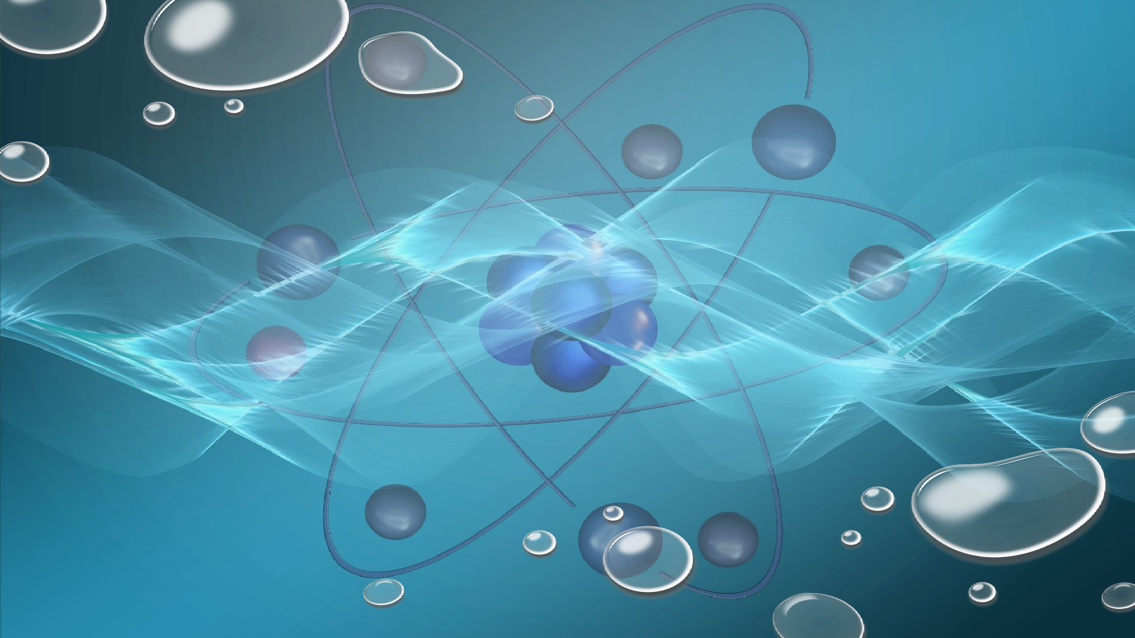
TO INVESTIGATE THE THERMOLUMINESCENT PROPERTIES OF SYNTHESIZED NANOPHOSPHORS FOR USE IN RADIATION DOSIMETRY
By:
Meemik Roy
Sri Venkateswara College, Delhi University
Under the guidance of:
Prof. Anant Pandey
Professor, Department of Physics
Sri Venkateswara College,
University of Delhi

Slide 2

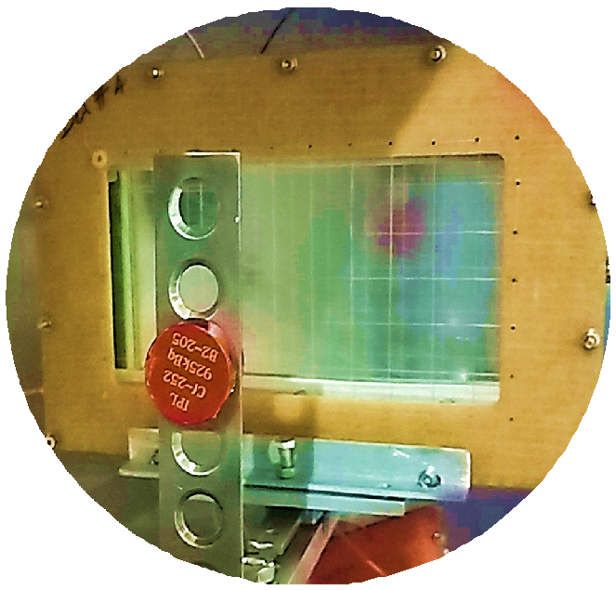

1 Introduction
2
Thermoluminescence Dosimetry
3
CaNa₂(SO₄)₂
4
Li₂SiO₃
5
Conclusion

Slide 3
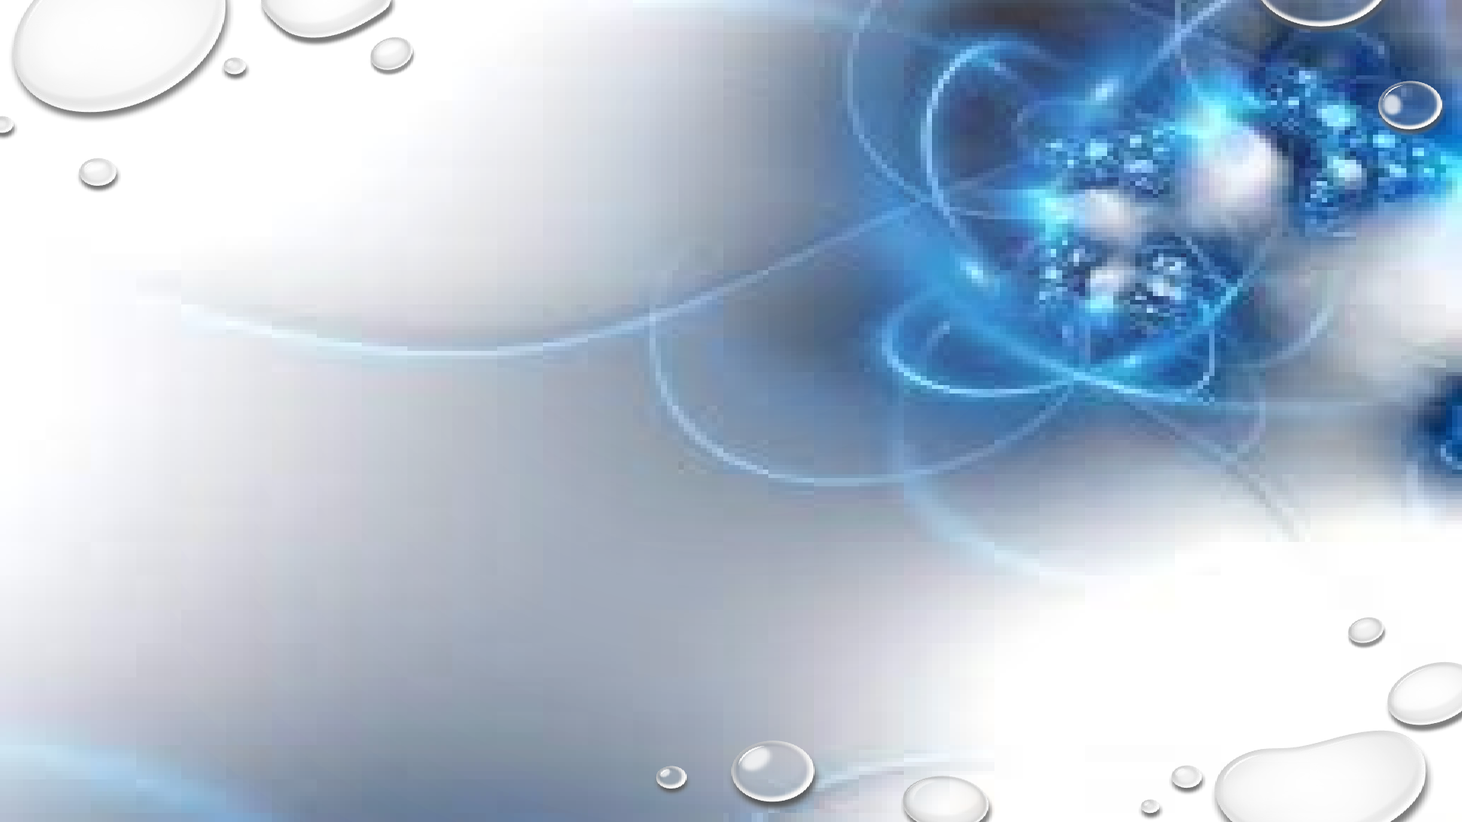
Introduction

Slide 4

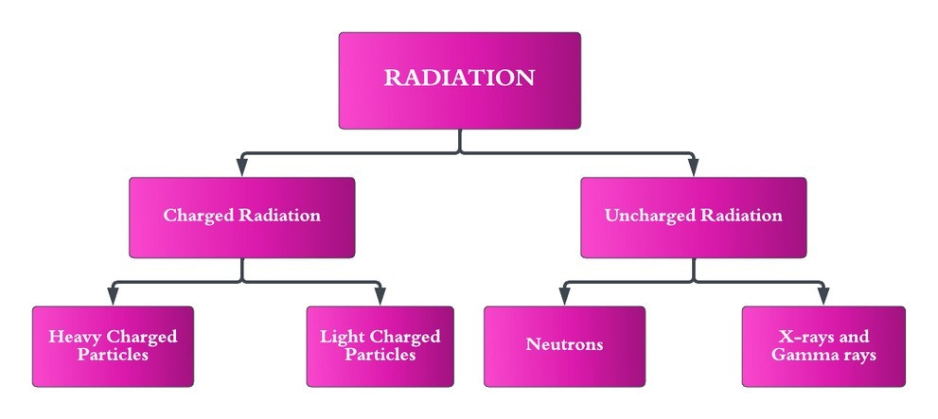
RADIATION
Radiation is the transfer of energy through electromagnetic waves or subatomic particles.
Understanding the nature, types, sources, and effects of radiation is essential for ensuring its safe and responsible use.
RADIATION DOSIMETRY
Radiation Dosimetry is the science and practice of measuring and assessing the dose of ionizing radiation received by an object or an individual.
By accurately quantifying radiation doses, dosimetry enables the evaluation of potential health risks, optimization of radiation procedures, and adherence to safety standards.

Slide 5
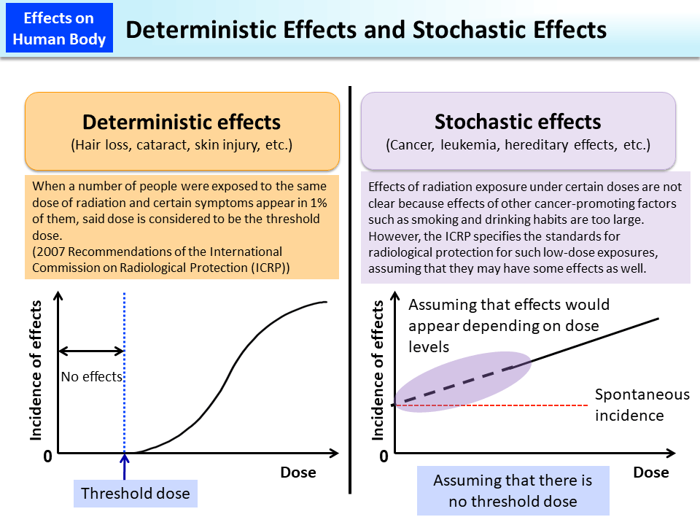
Effects of Radiation
The effects of radiation on living organisms can be divided into two main categories: deterministic effects and stochastic effects. These effects depend on various factors, including the type of radiation, the dose received, and the duration of exposure.

Slide 6

Thermoluminescence Dosimetry

Slide 7
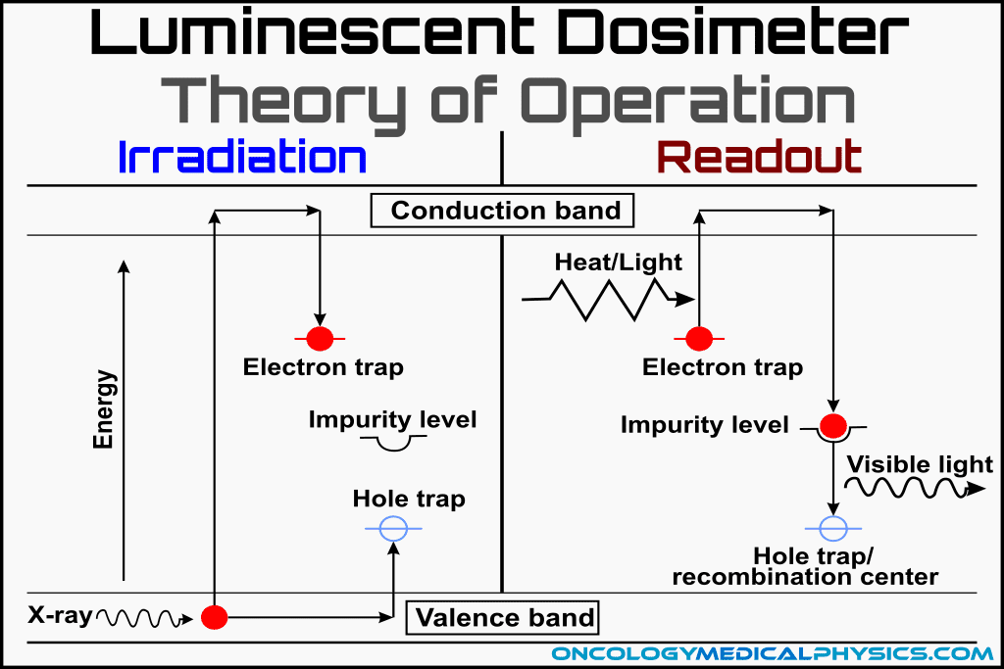
Thermoluminescence
Thermoluminescence (TL) is a luminescence phenomenon of an insulator or semiconductor which can be observed when the solid is thermally stimulated.
In order for a material to be thermoluminous, it must first be an insulator or a semiconductor because metals do not show thermoluminescence.
Energy must have been absorbed by the substance at some point while it was exposed to ionising radiation.
Material must be heated for luminescence to occur

Slide 8
Properties of ideal dosimeter
Accuracy: An ideal dosimeter should provide accurate measurements of radiation doses.
Sensitivity: The dosimeter should be highly sensitive to radiation, capable of detecting even low levels of radiation exposure.
Stability: An ideal dosimeter should exhibit stability over time, meaning its response to radiation doses remains consistent throughout its operational lifespan.
Energy Dependence: The dosimeter should have minimal energy dependence, meaning it should provide consistent dose measurements across a broad range of radiation energies and types
Linearity: The dosimeter’s response should be linear across a wide range of dose levels.
Tissue-Equivalent: An ideal dosimeter should mimic the radiation absorption characteristics of human tissue.
•
•
•

Slide 9

Calcium Sodium Sulphate CaNa₂(SO₄)₂

Slide 10

Synthesis

Slide 11
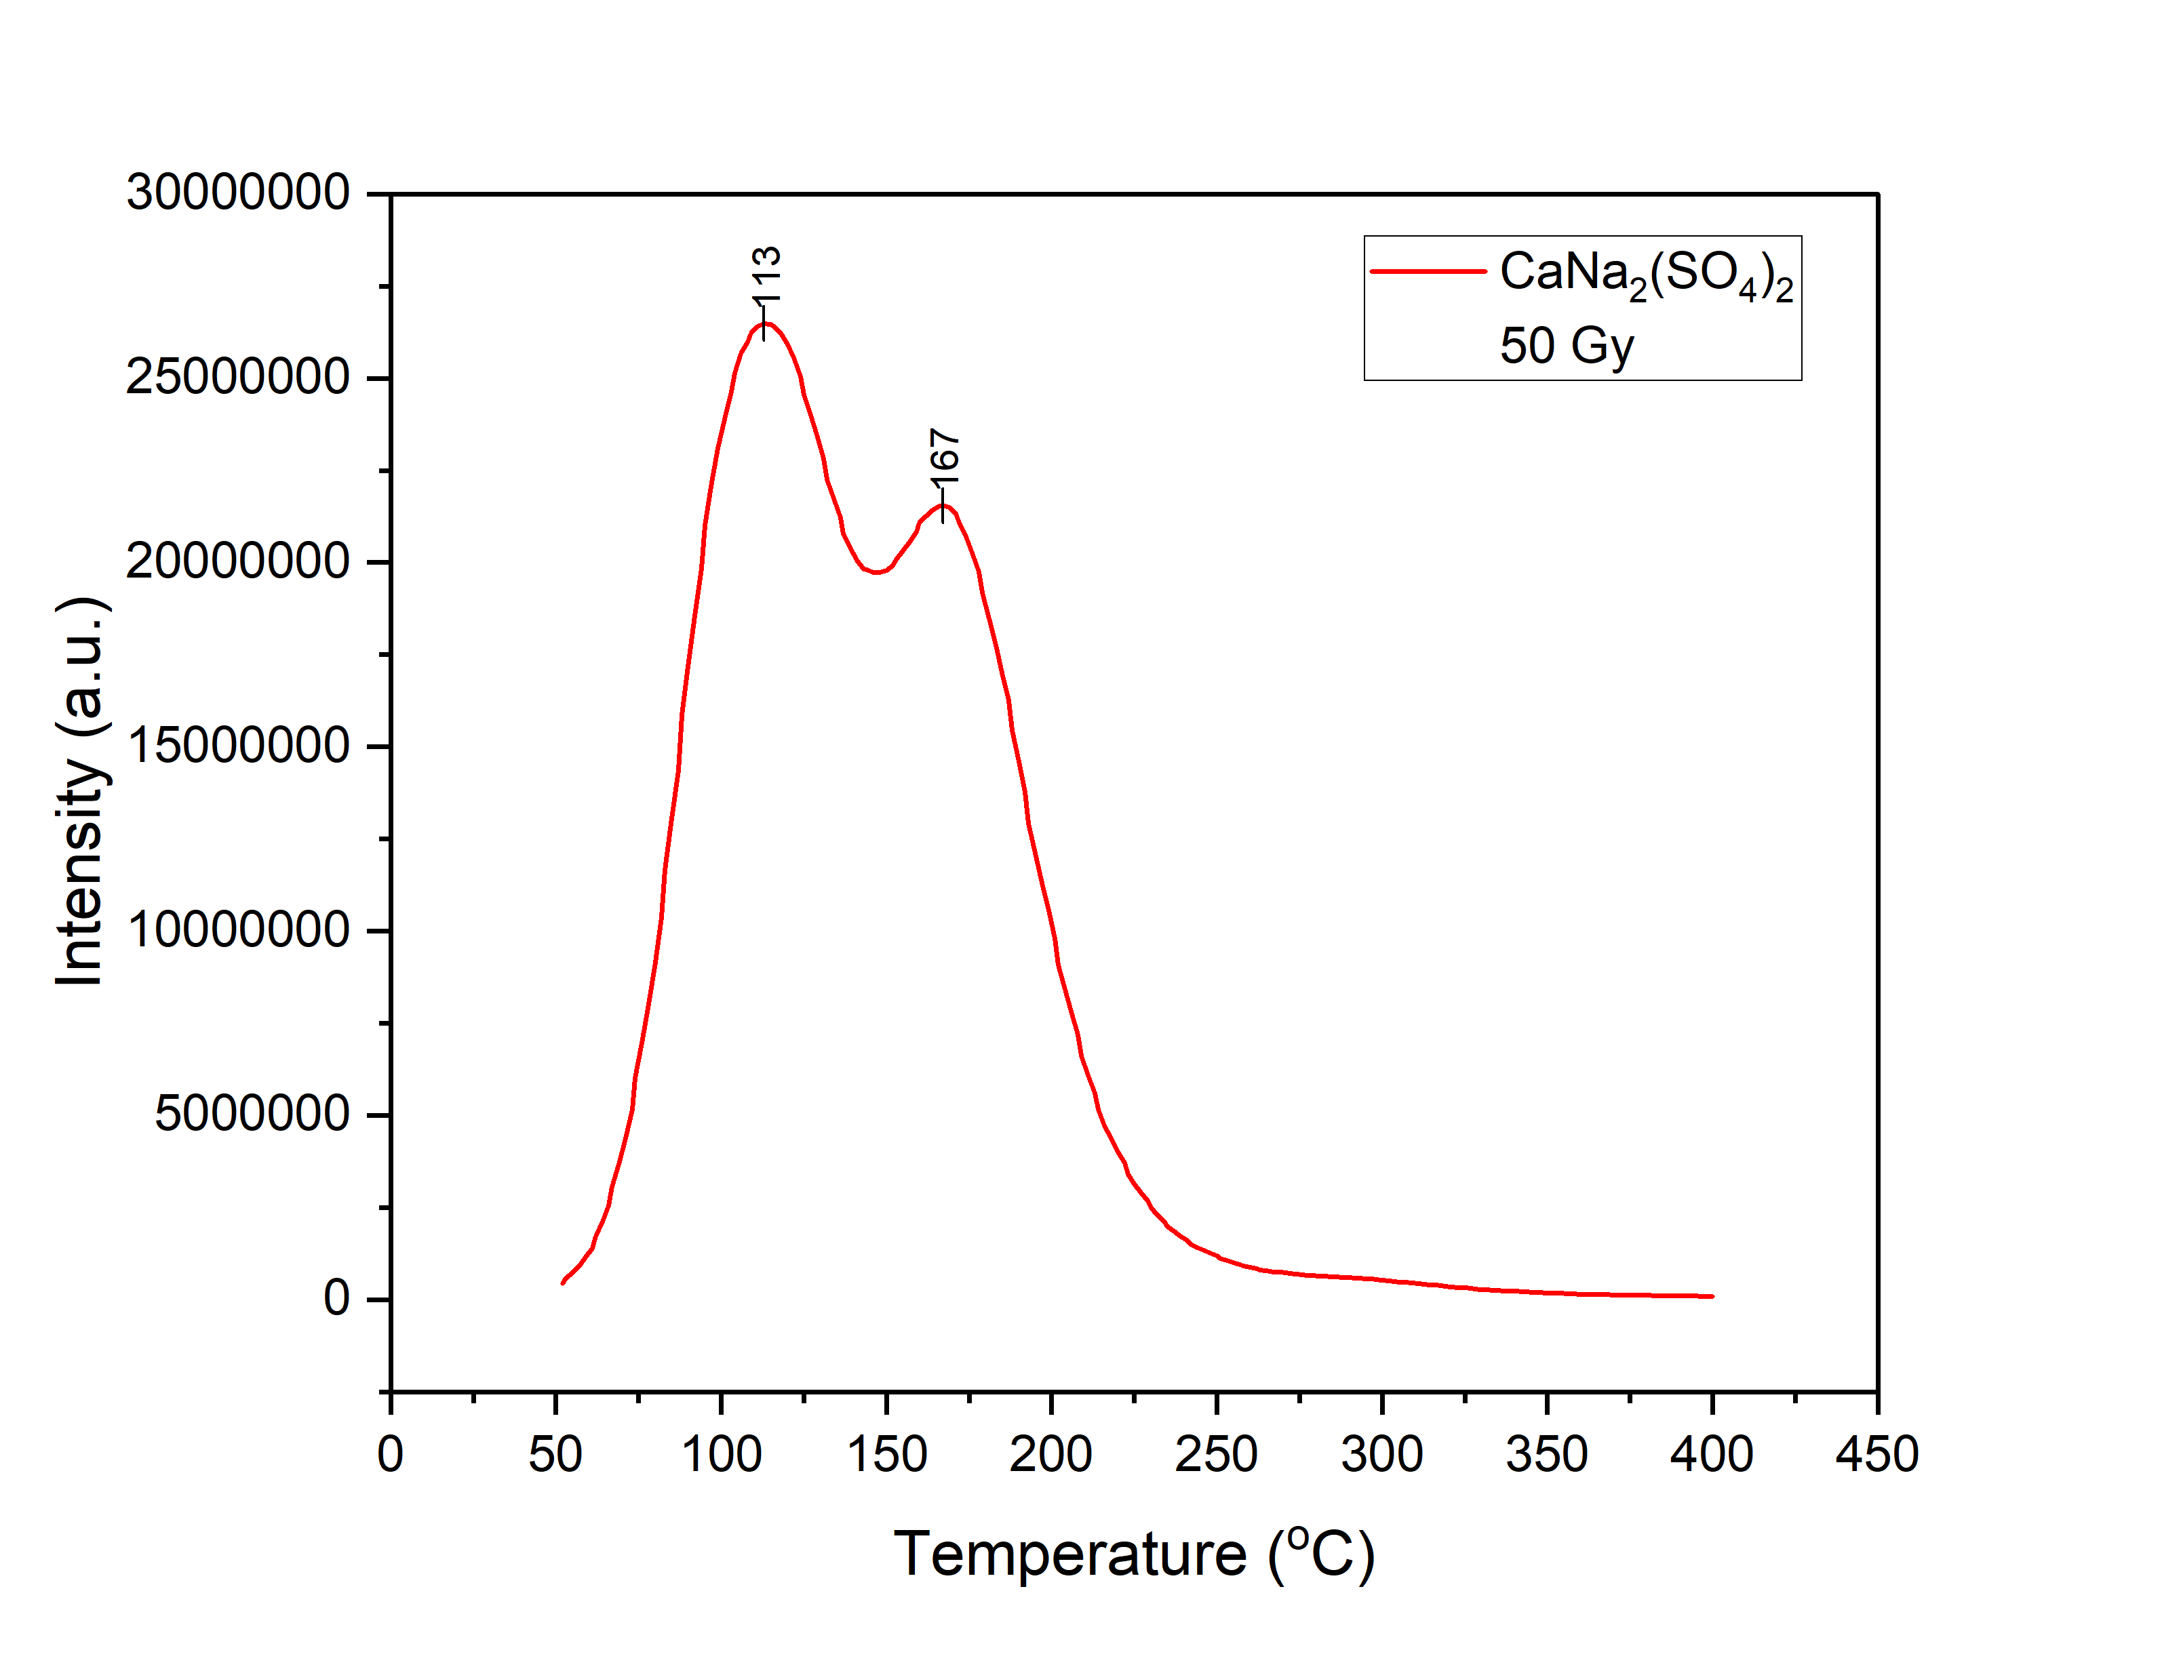
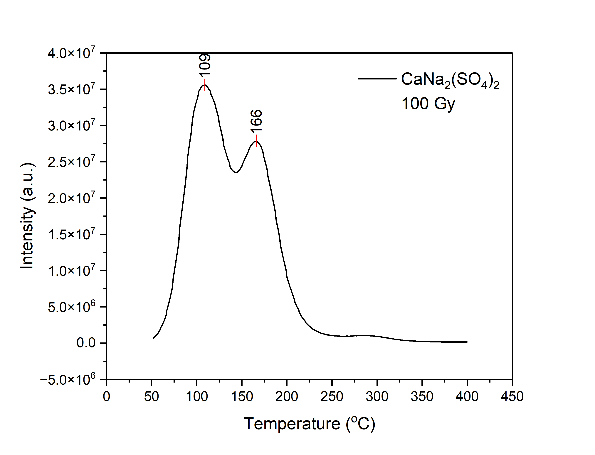
Results
Dose response for Calcium Sodium Sulphate
when irradiated with Gamma ray at 50 Gy
Dose response for Calcium Sodium Sulphate
when irradiated with Gamma ray at 100 Gy

Slide 12
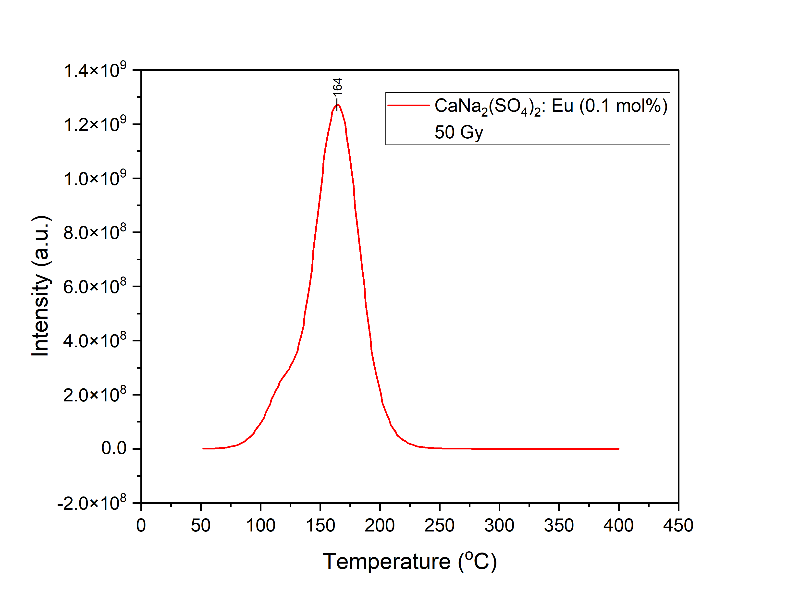
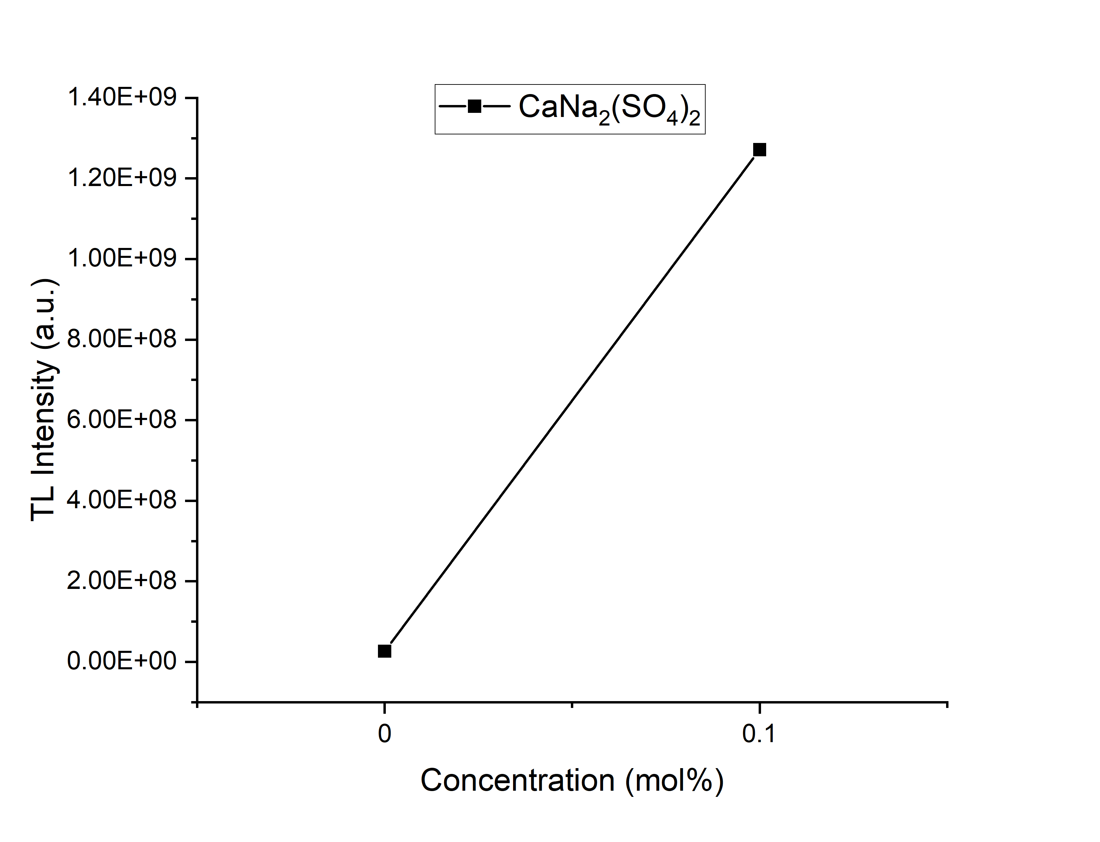
Results
Each tap in the chip is providing 2±0.5ns delay which is within the escribed values
Dose response for Calcium Sodium Sulphate after doping with Europium when irradiated with Gamma ray at 50 Gy
Effect of doping on dose response of Cal-
cium Sodium Sulphate

Slide 13

Lithium metasilicate Li₂SiO₃

Slide 14
Synthesis
•
•
•

Slide 15
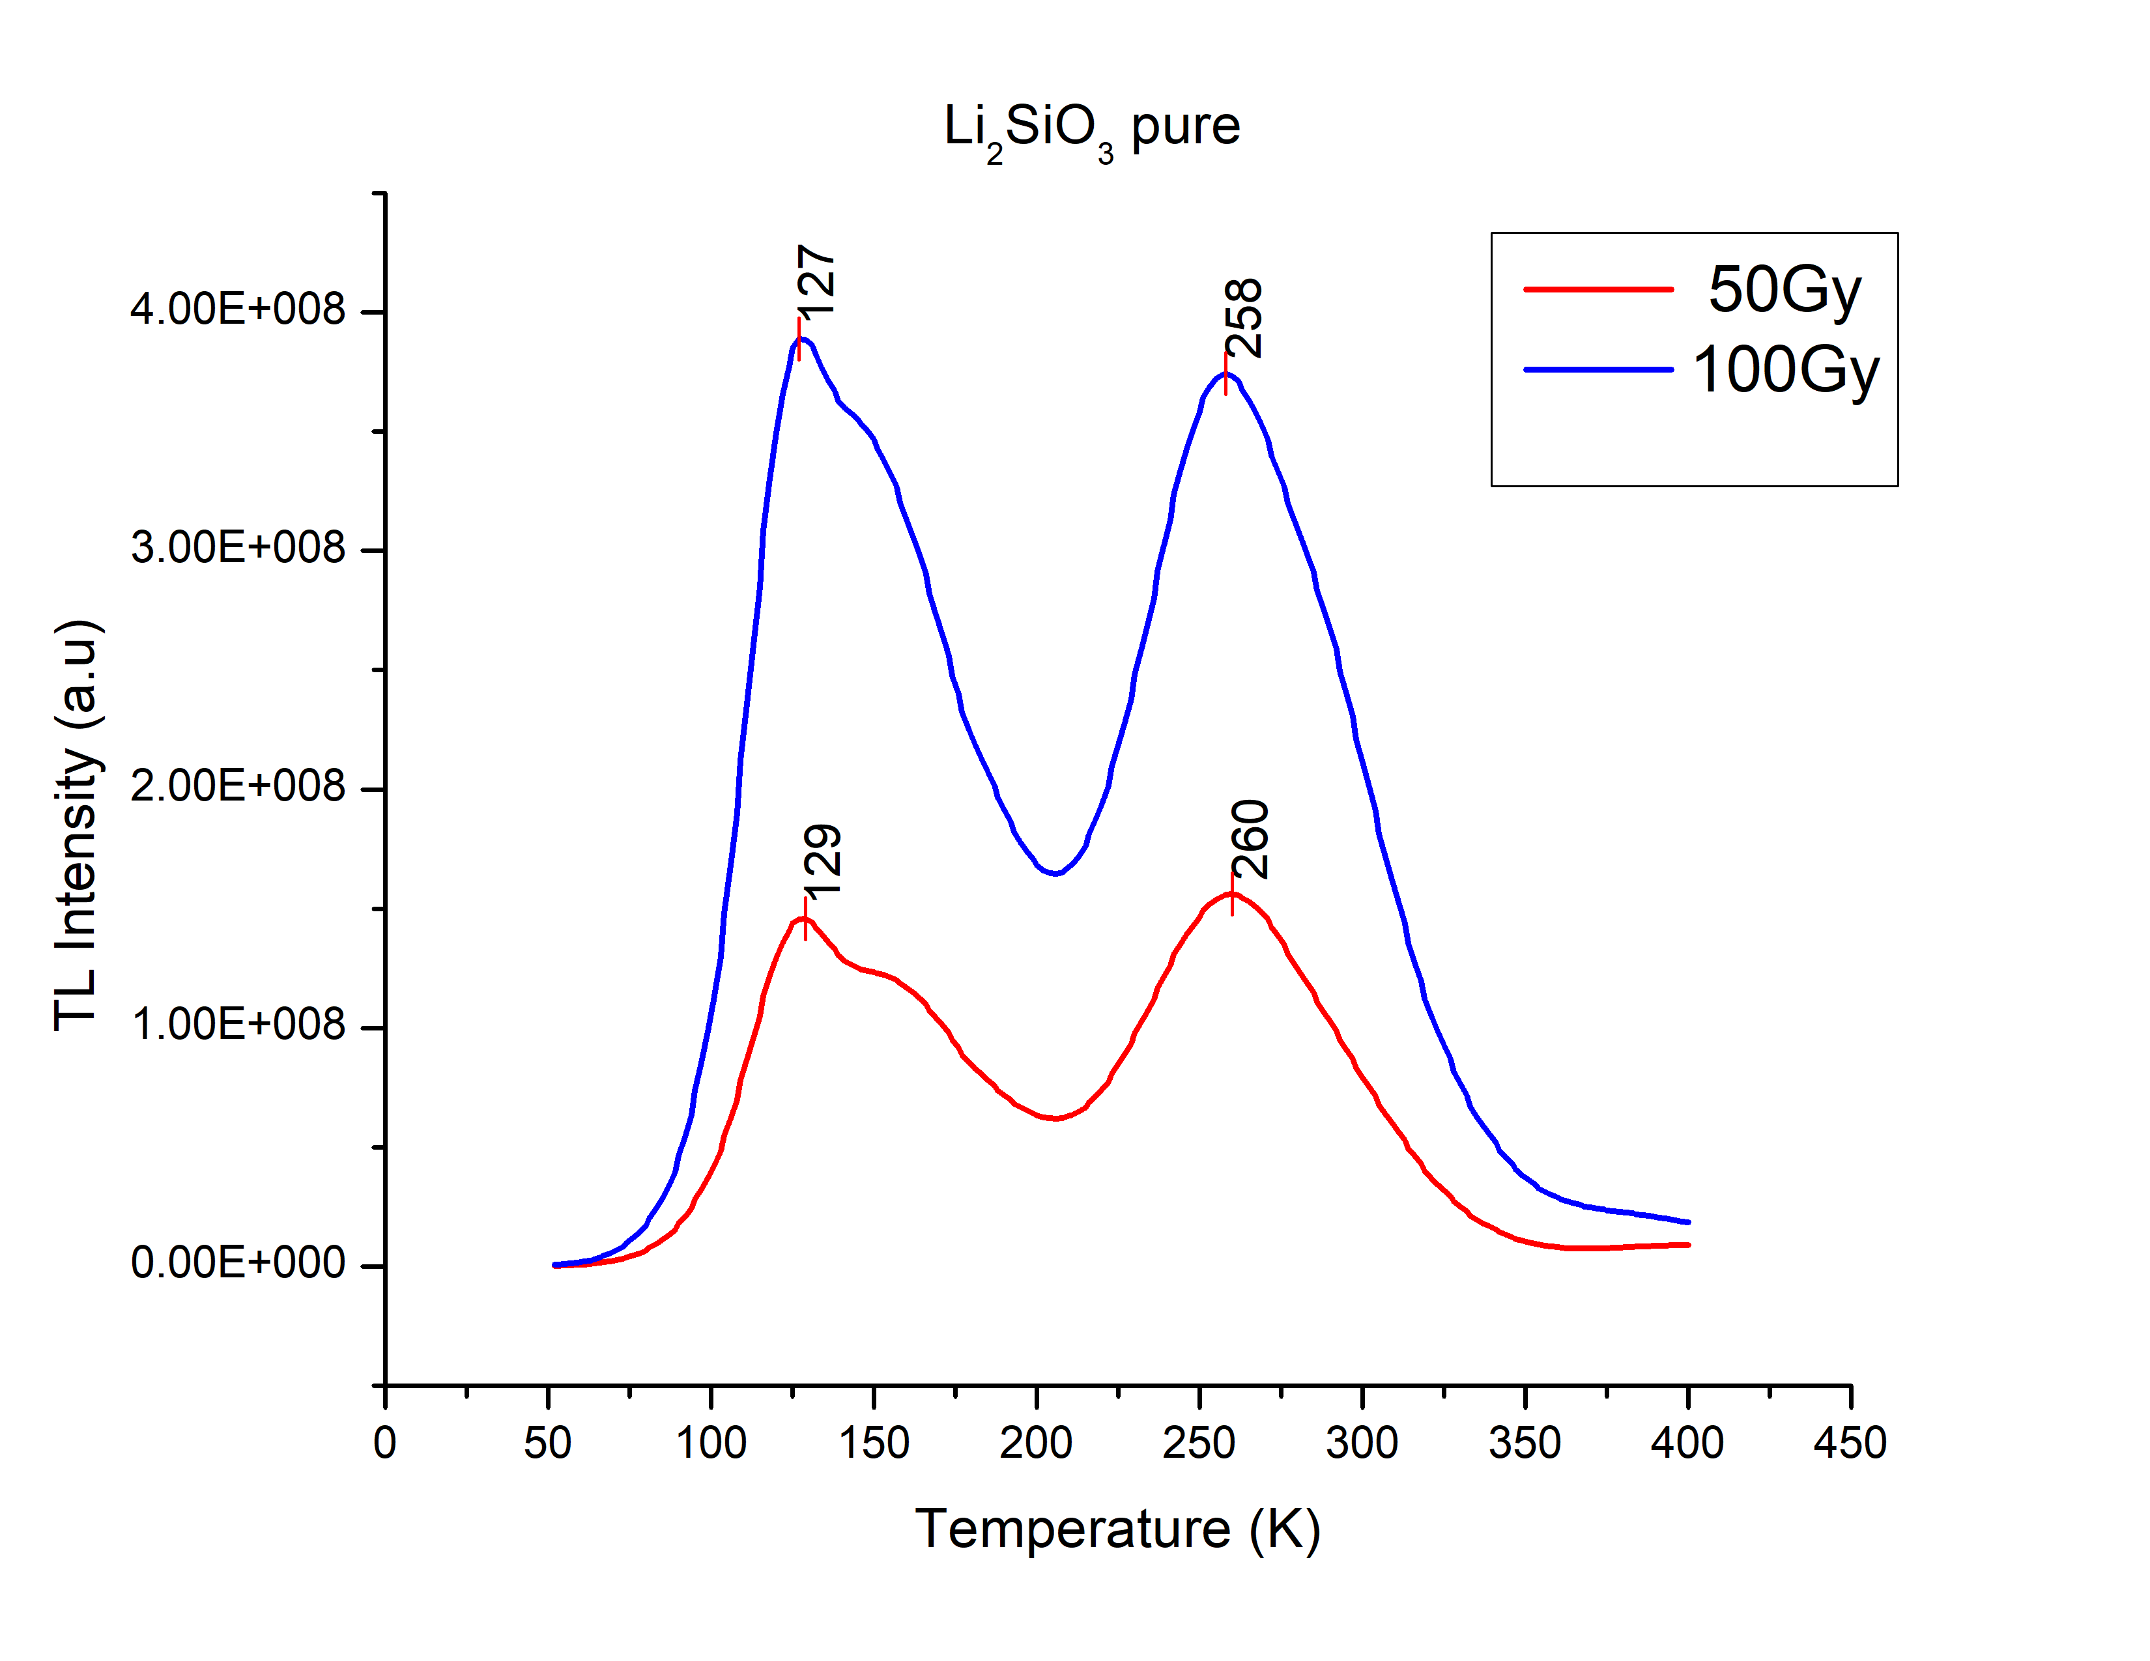
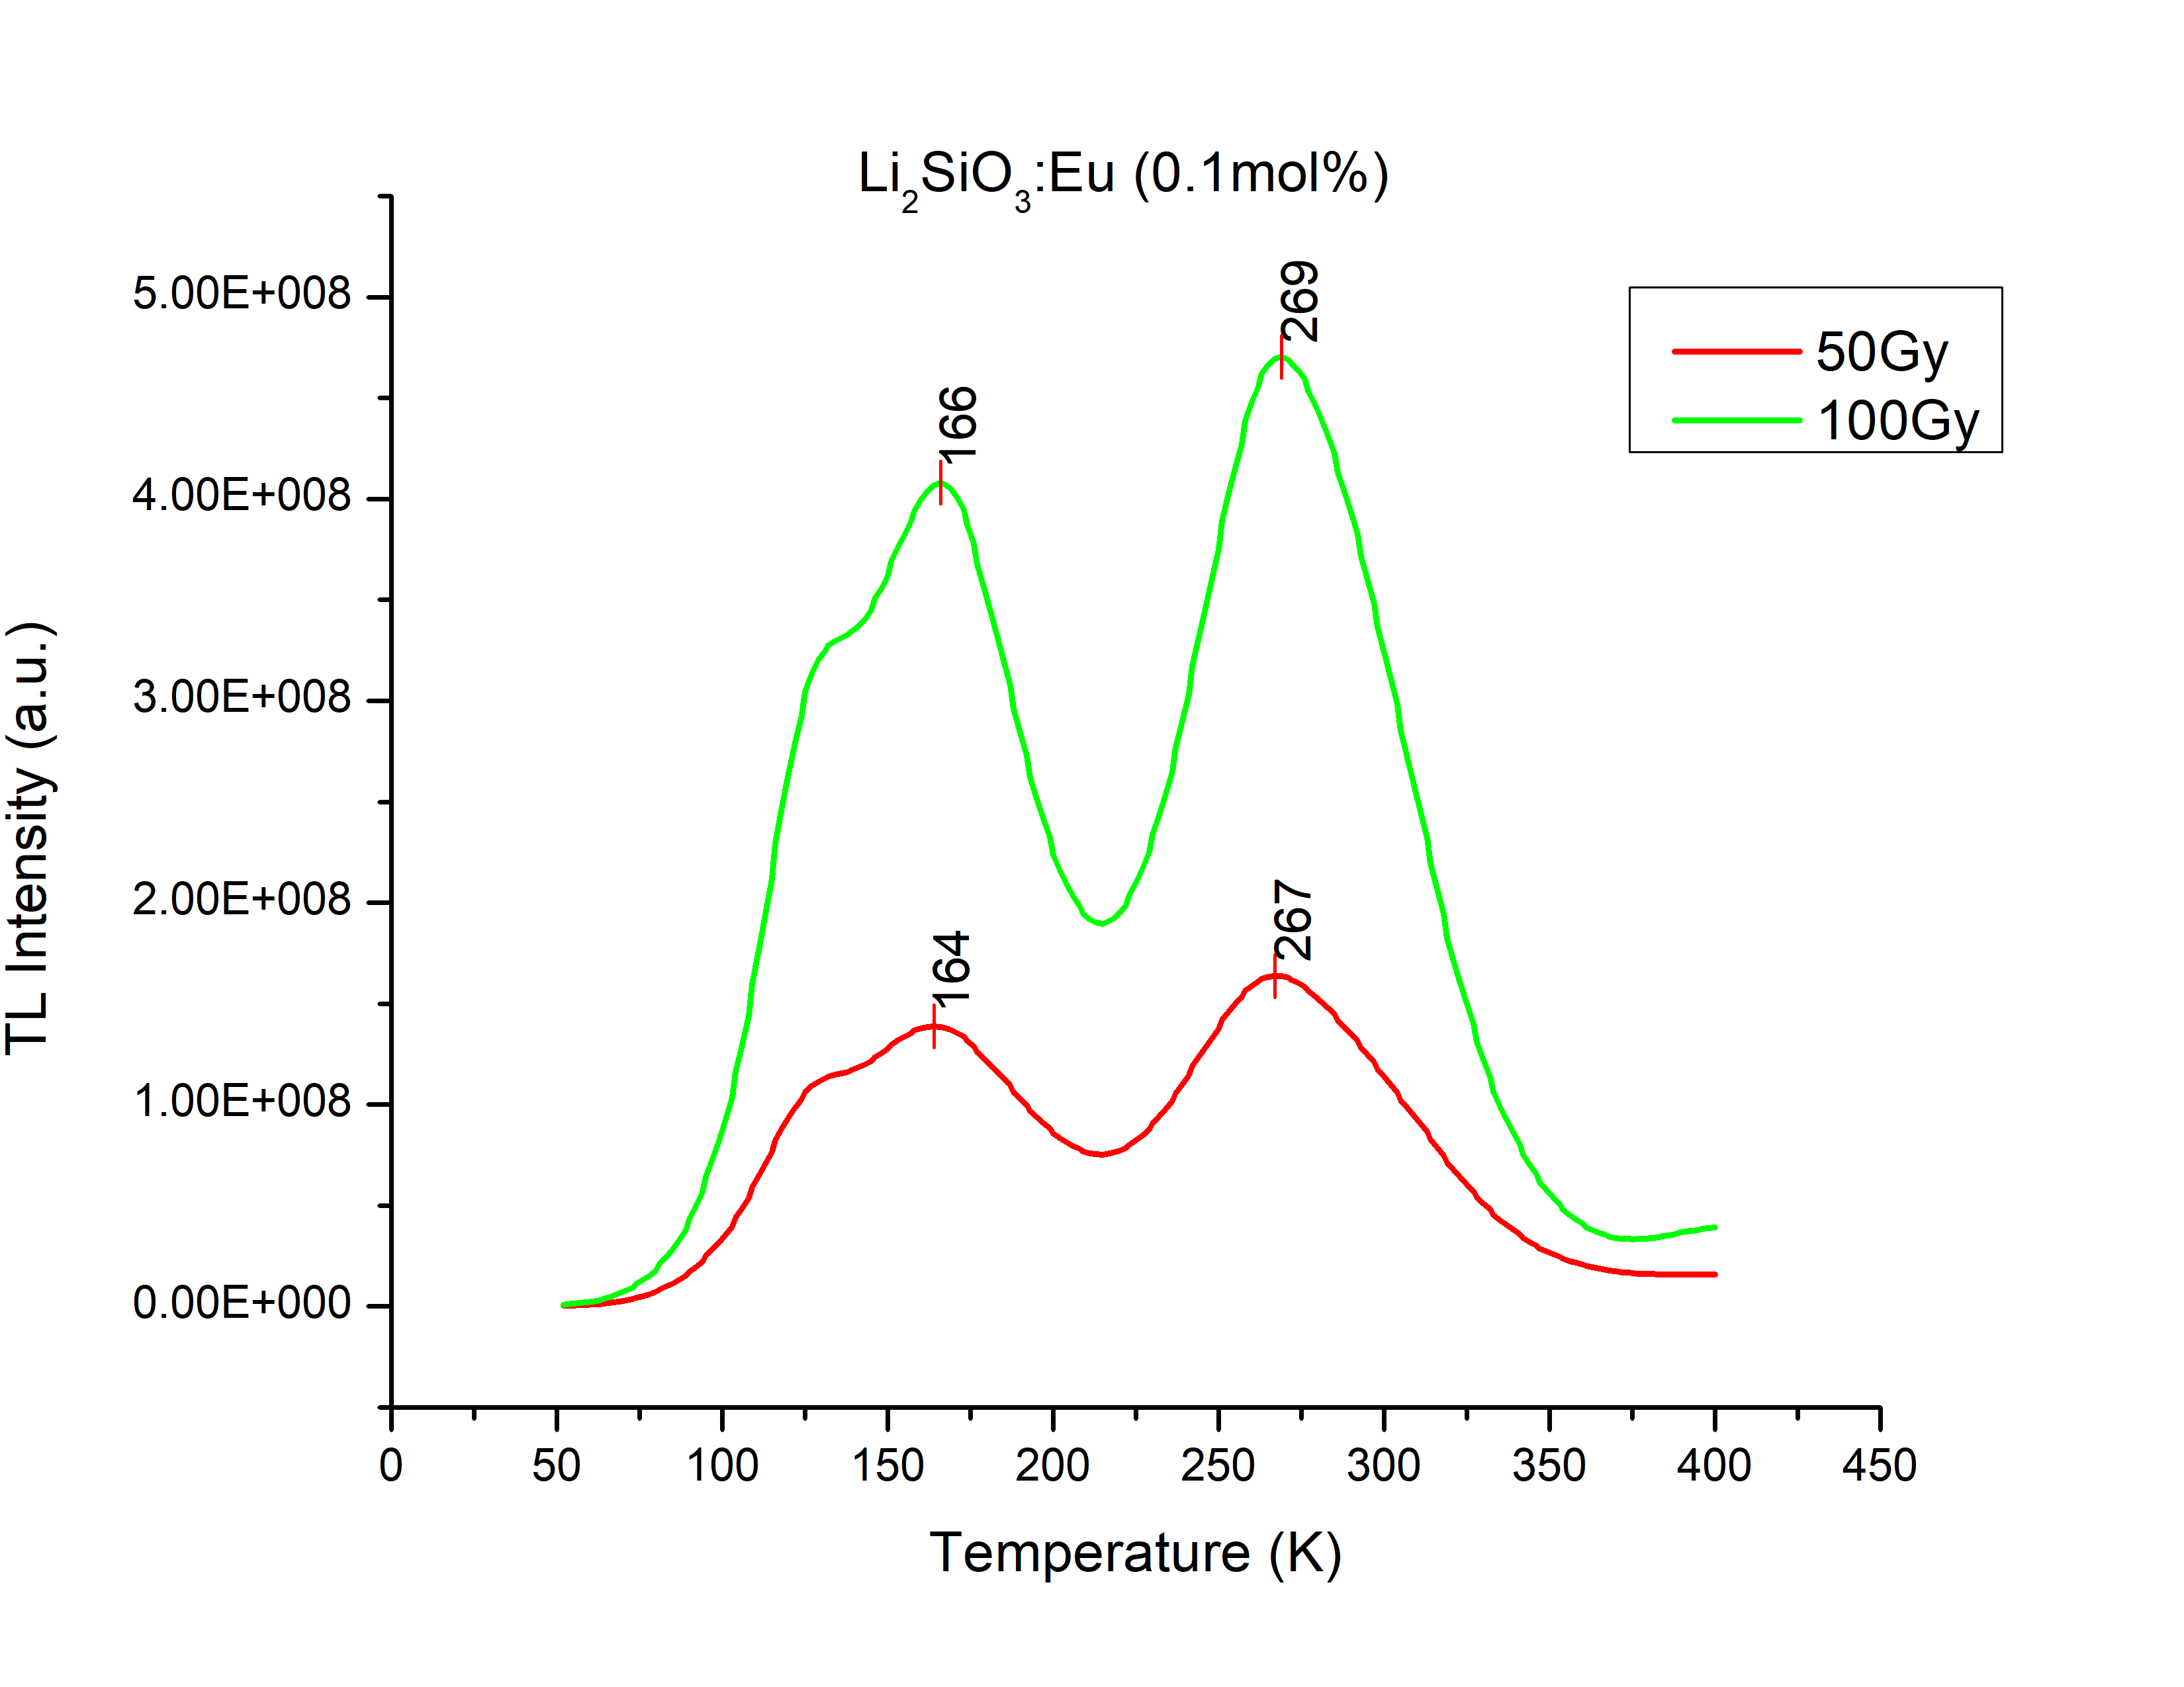
Results
•
•
•

Slide 16
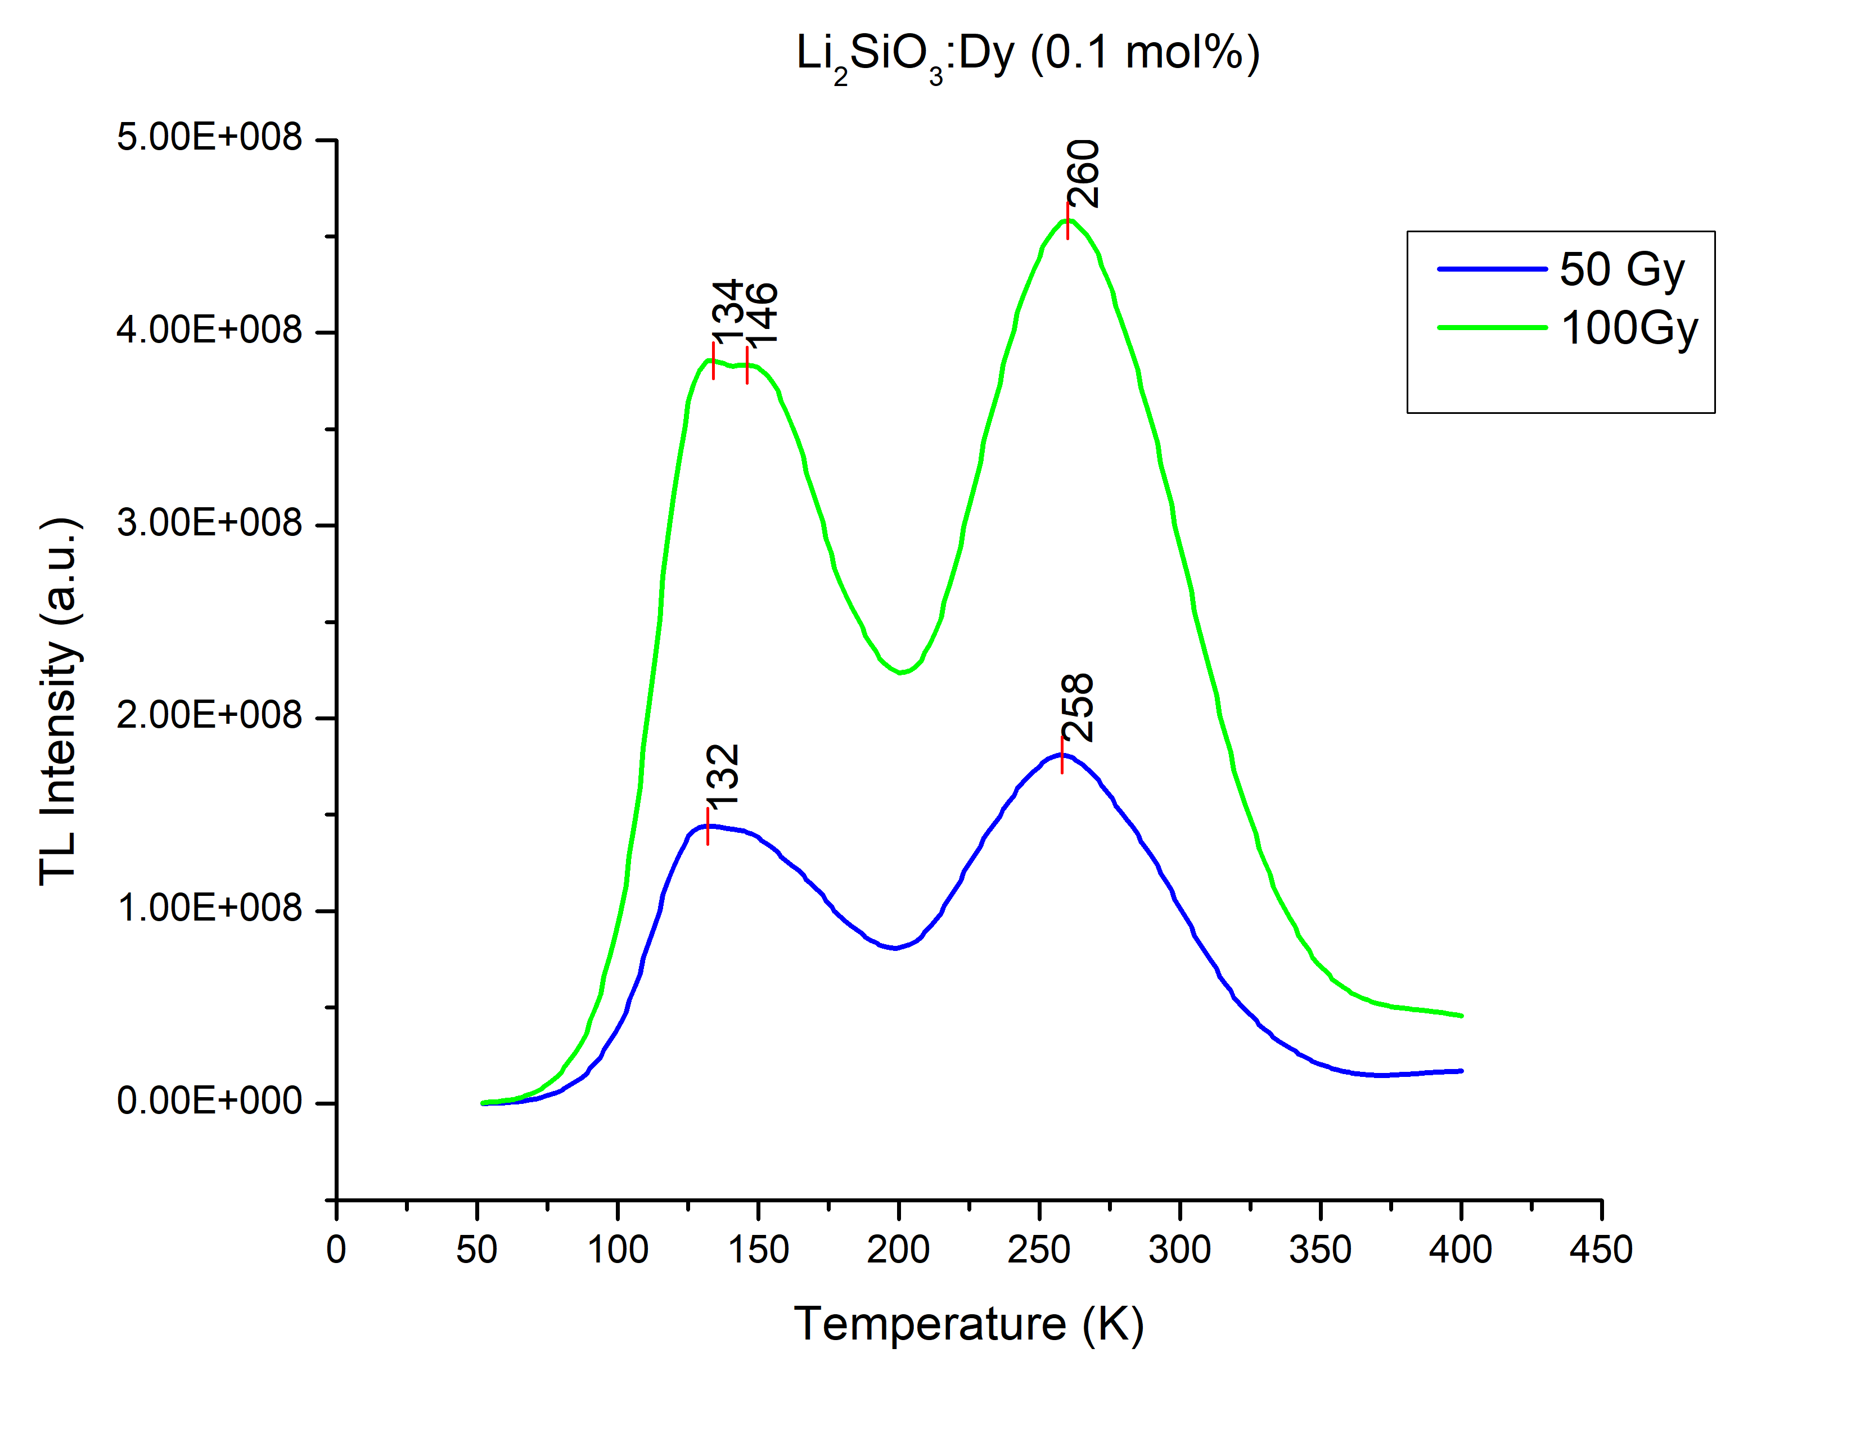
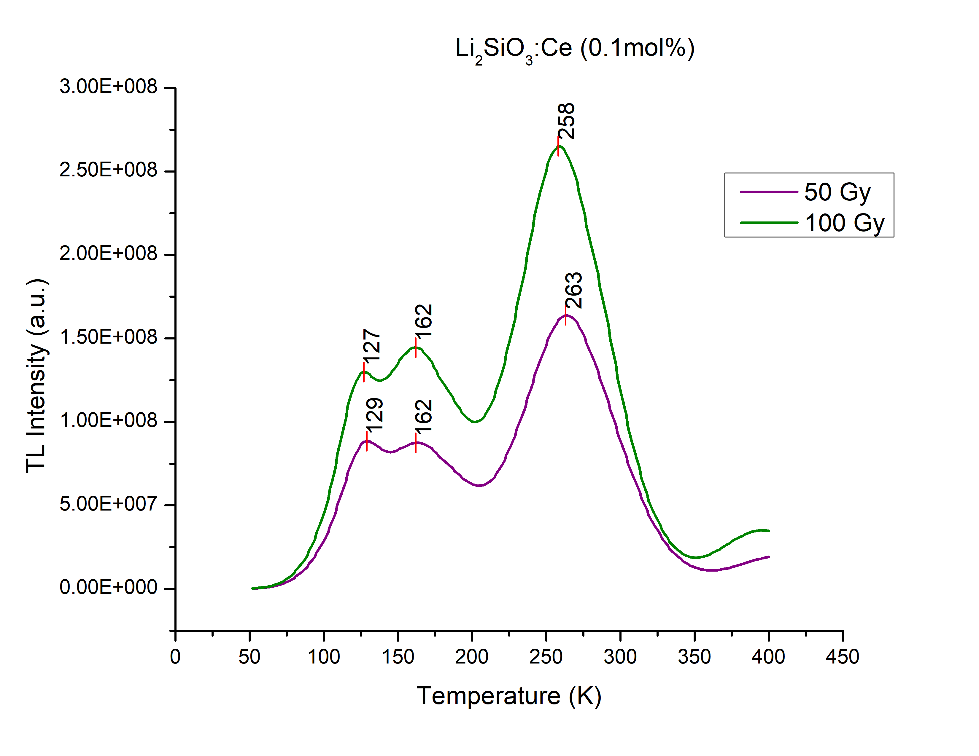
Results
•
•
•

Slide 17
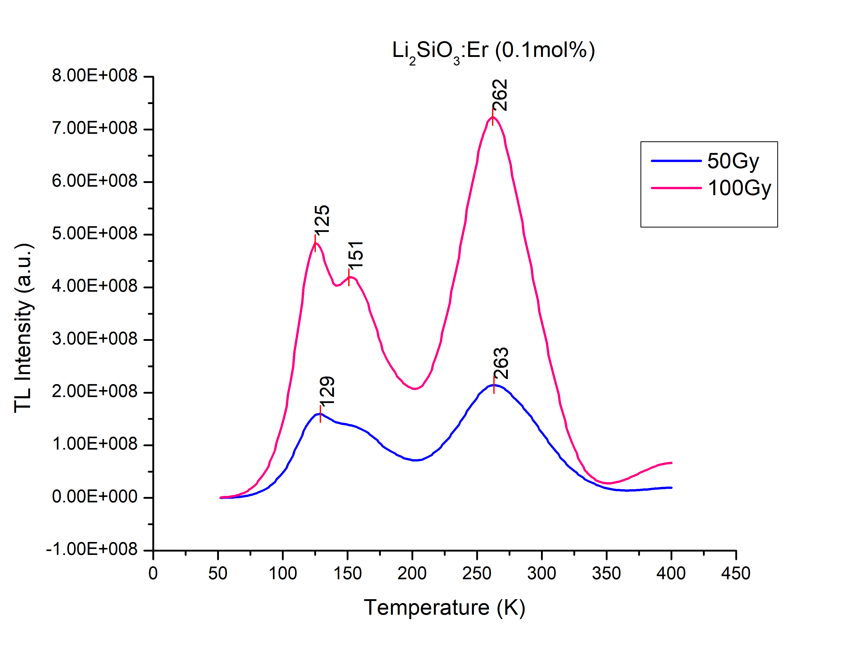
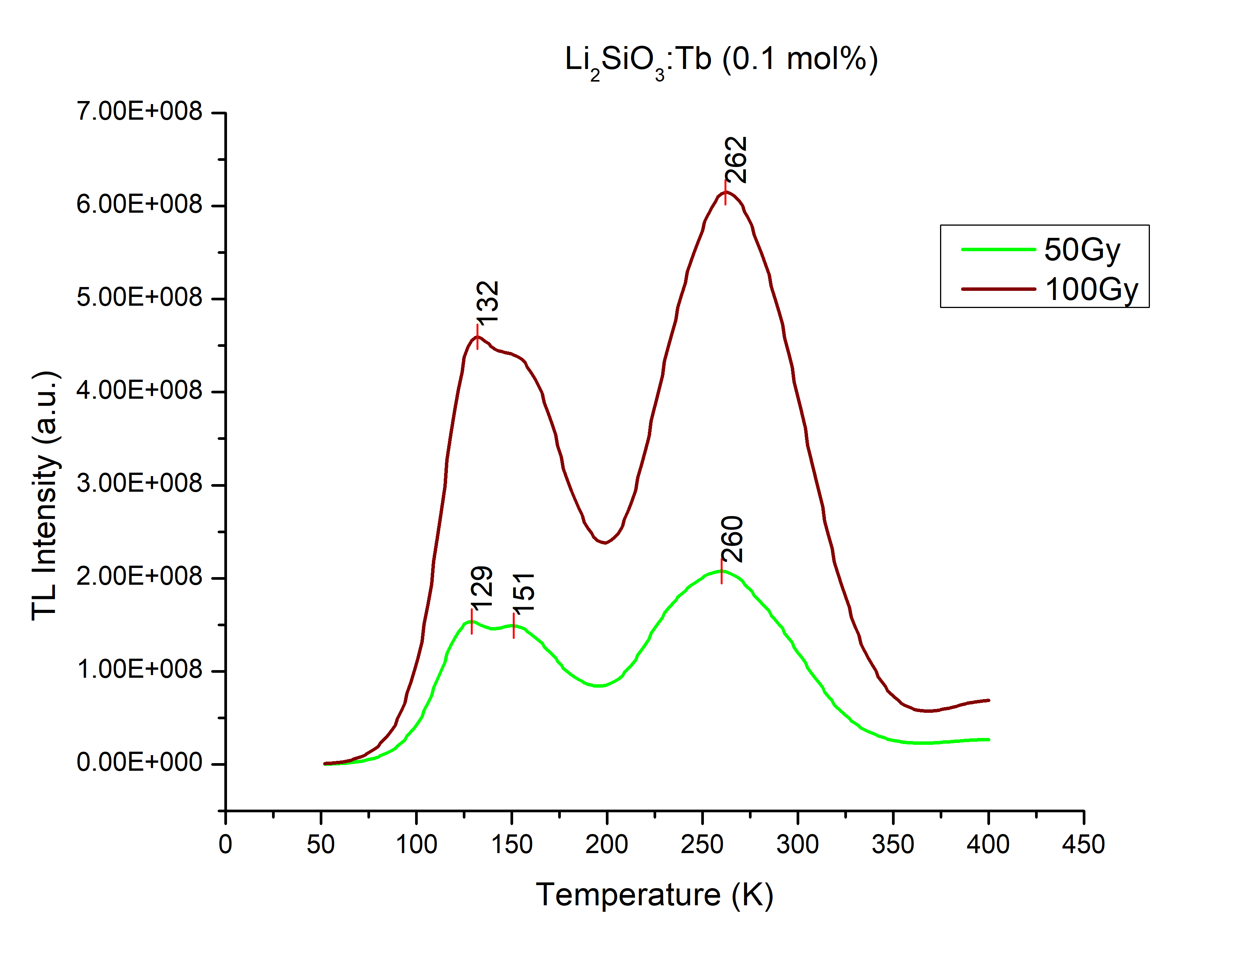
Results
•
•
•

Slide 18
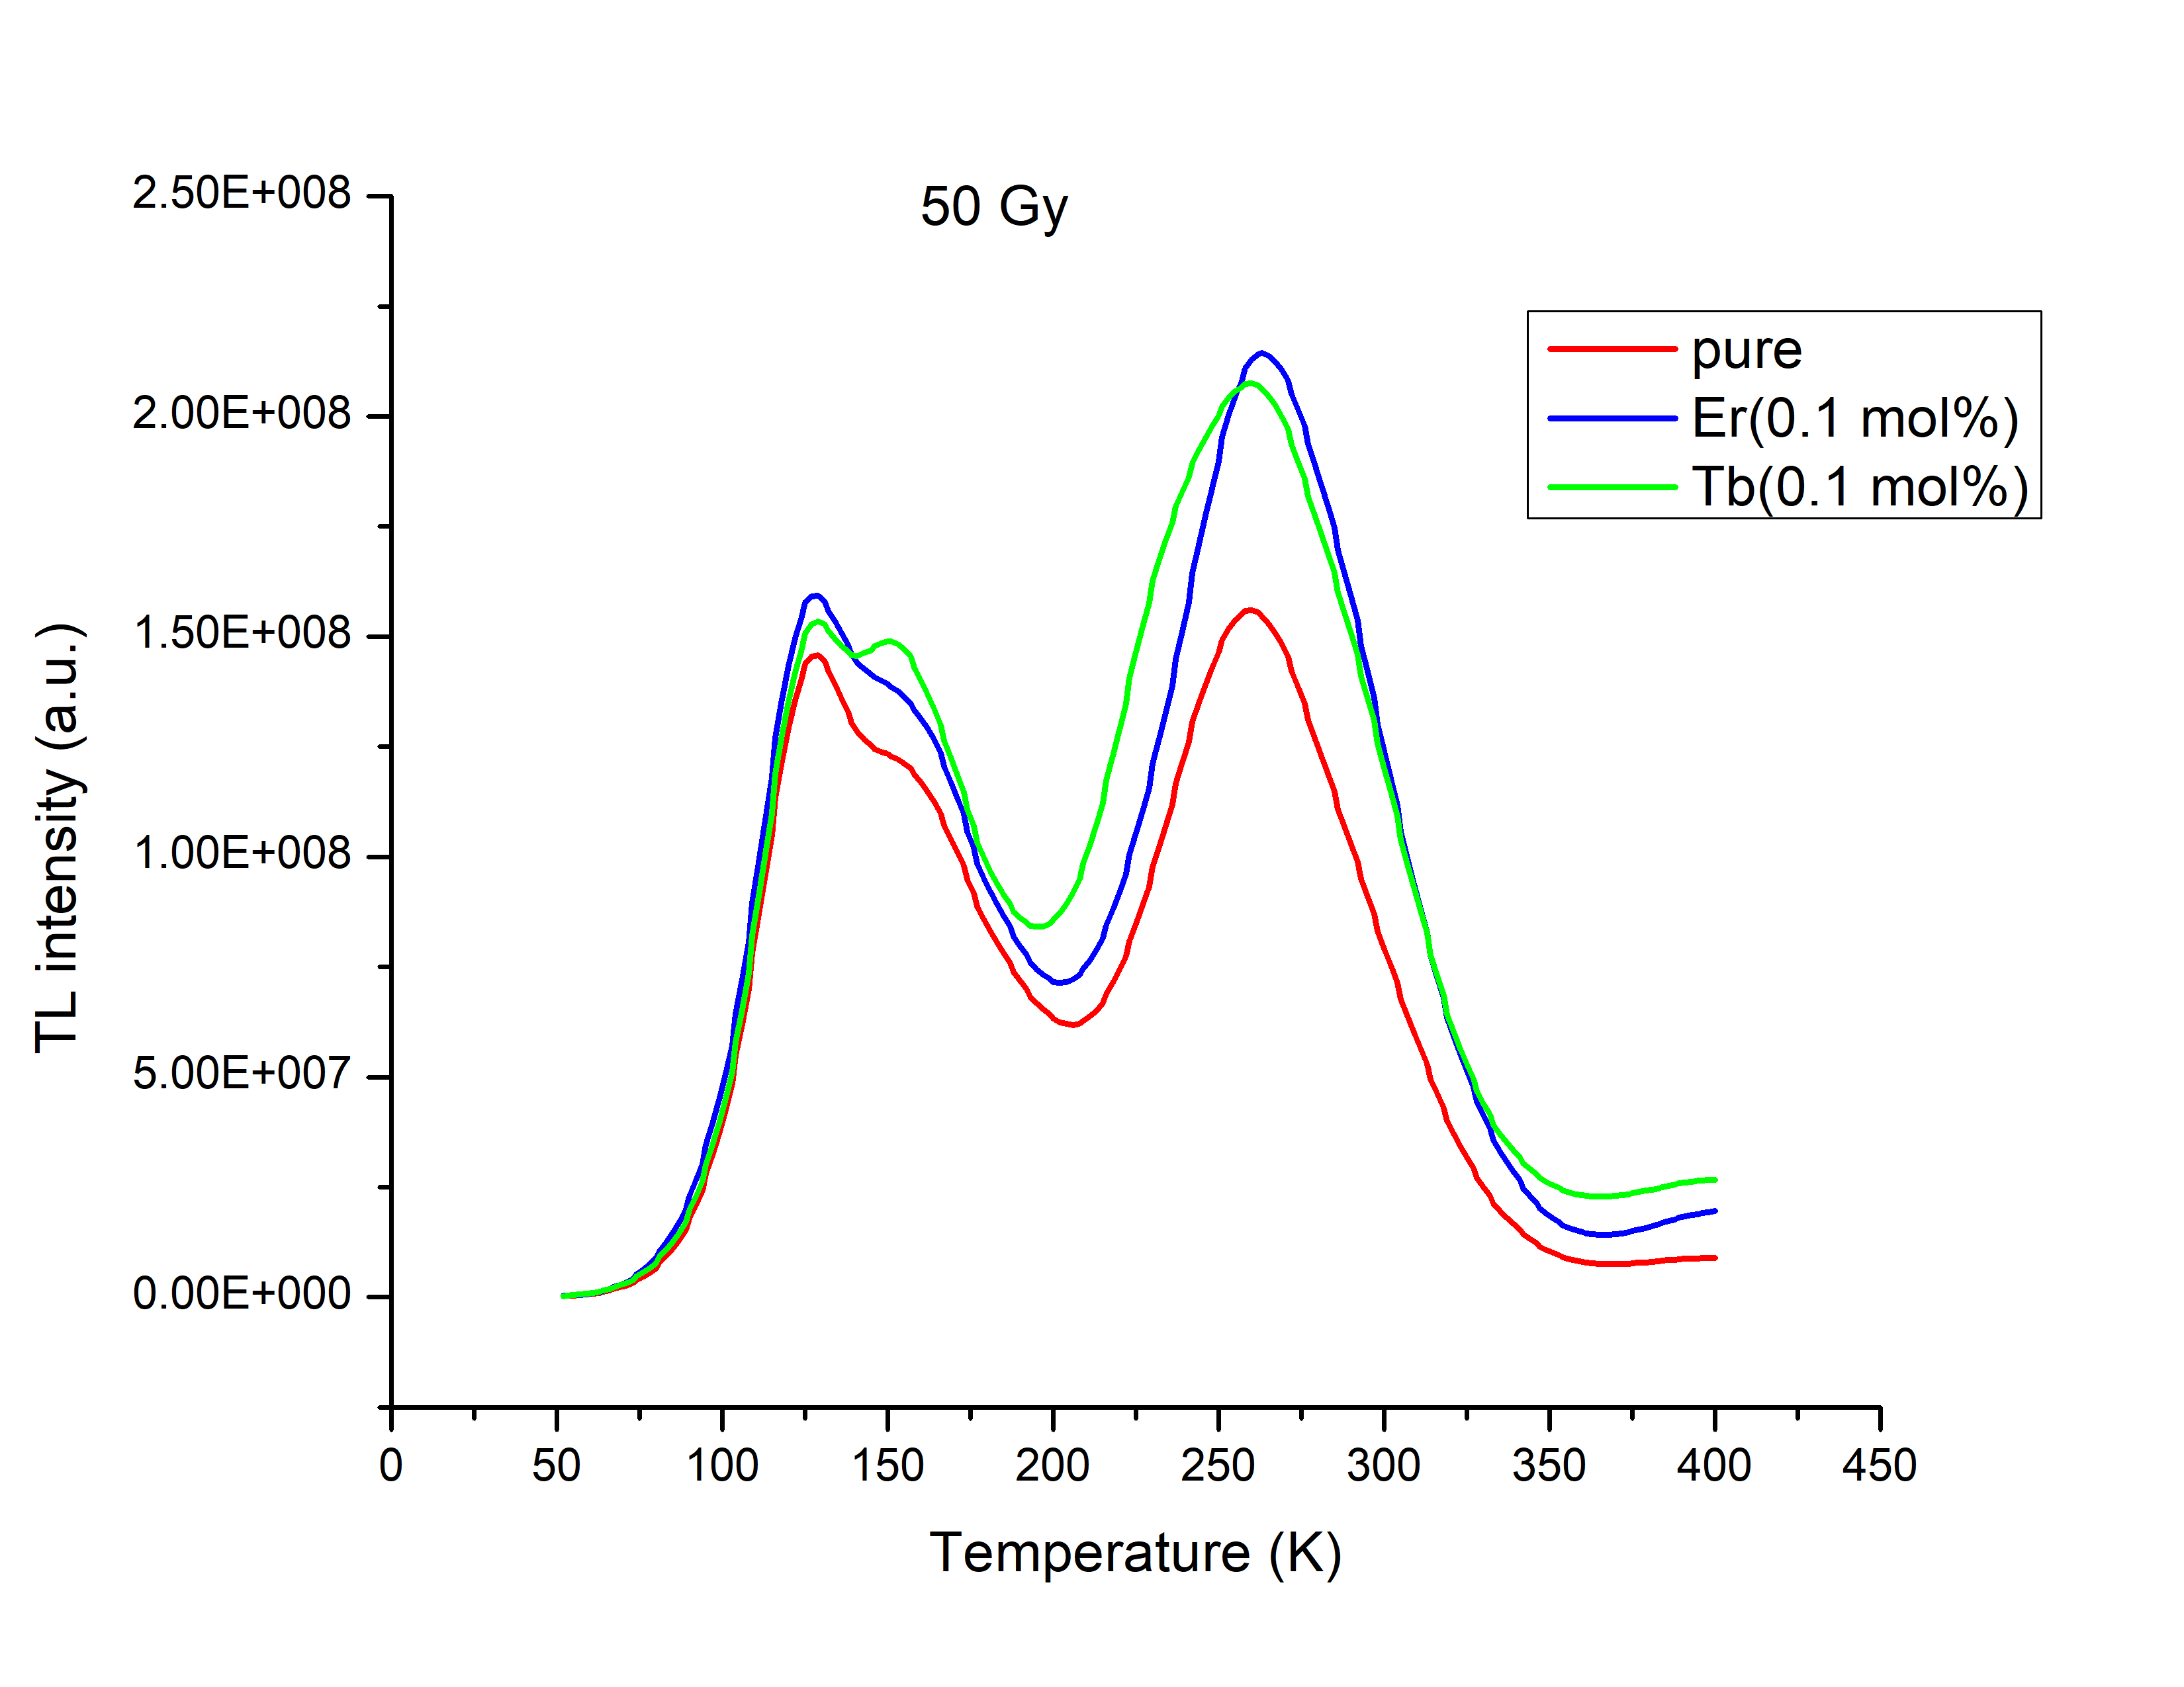
Effect of Doping
•
•
•

Slide 19
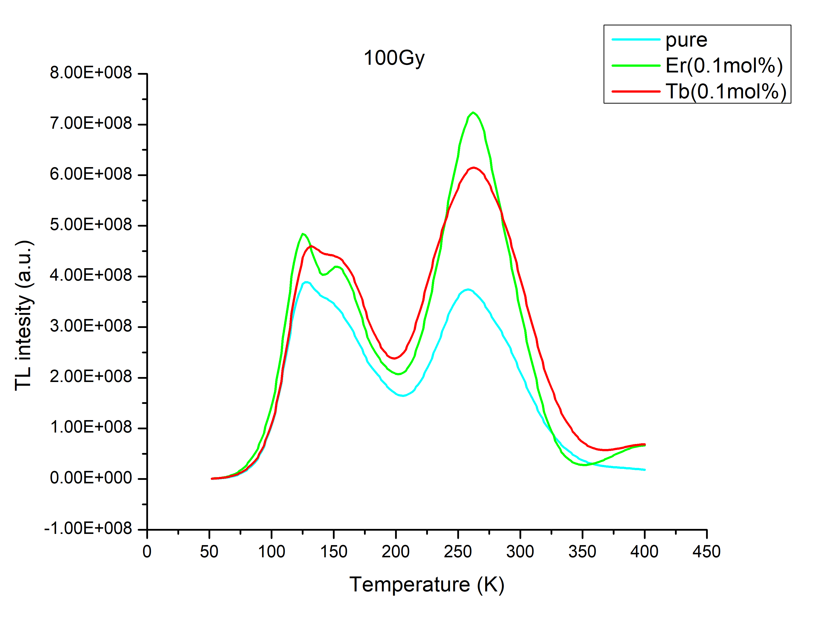
Effect of Doping
•
•
•

Slide 20
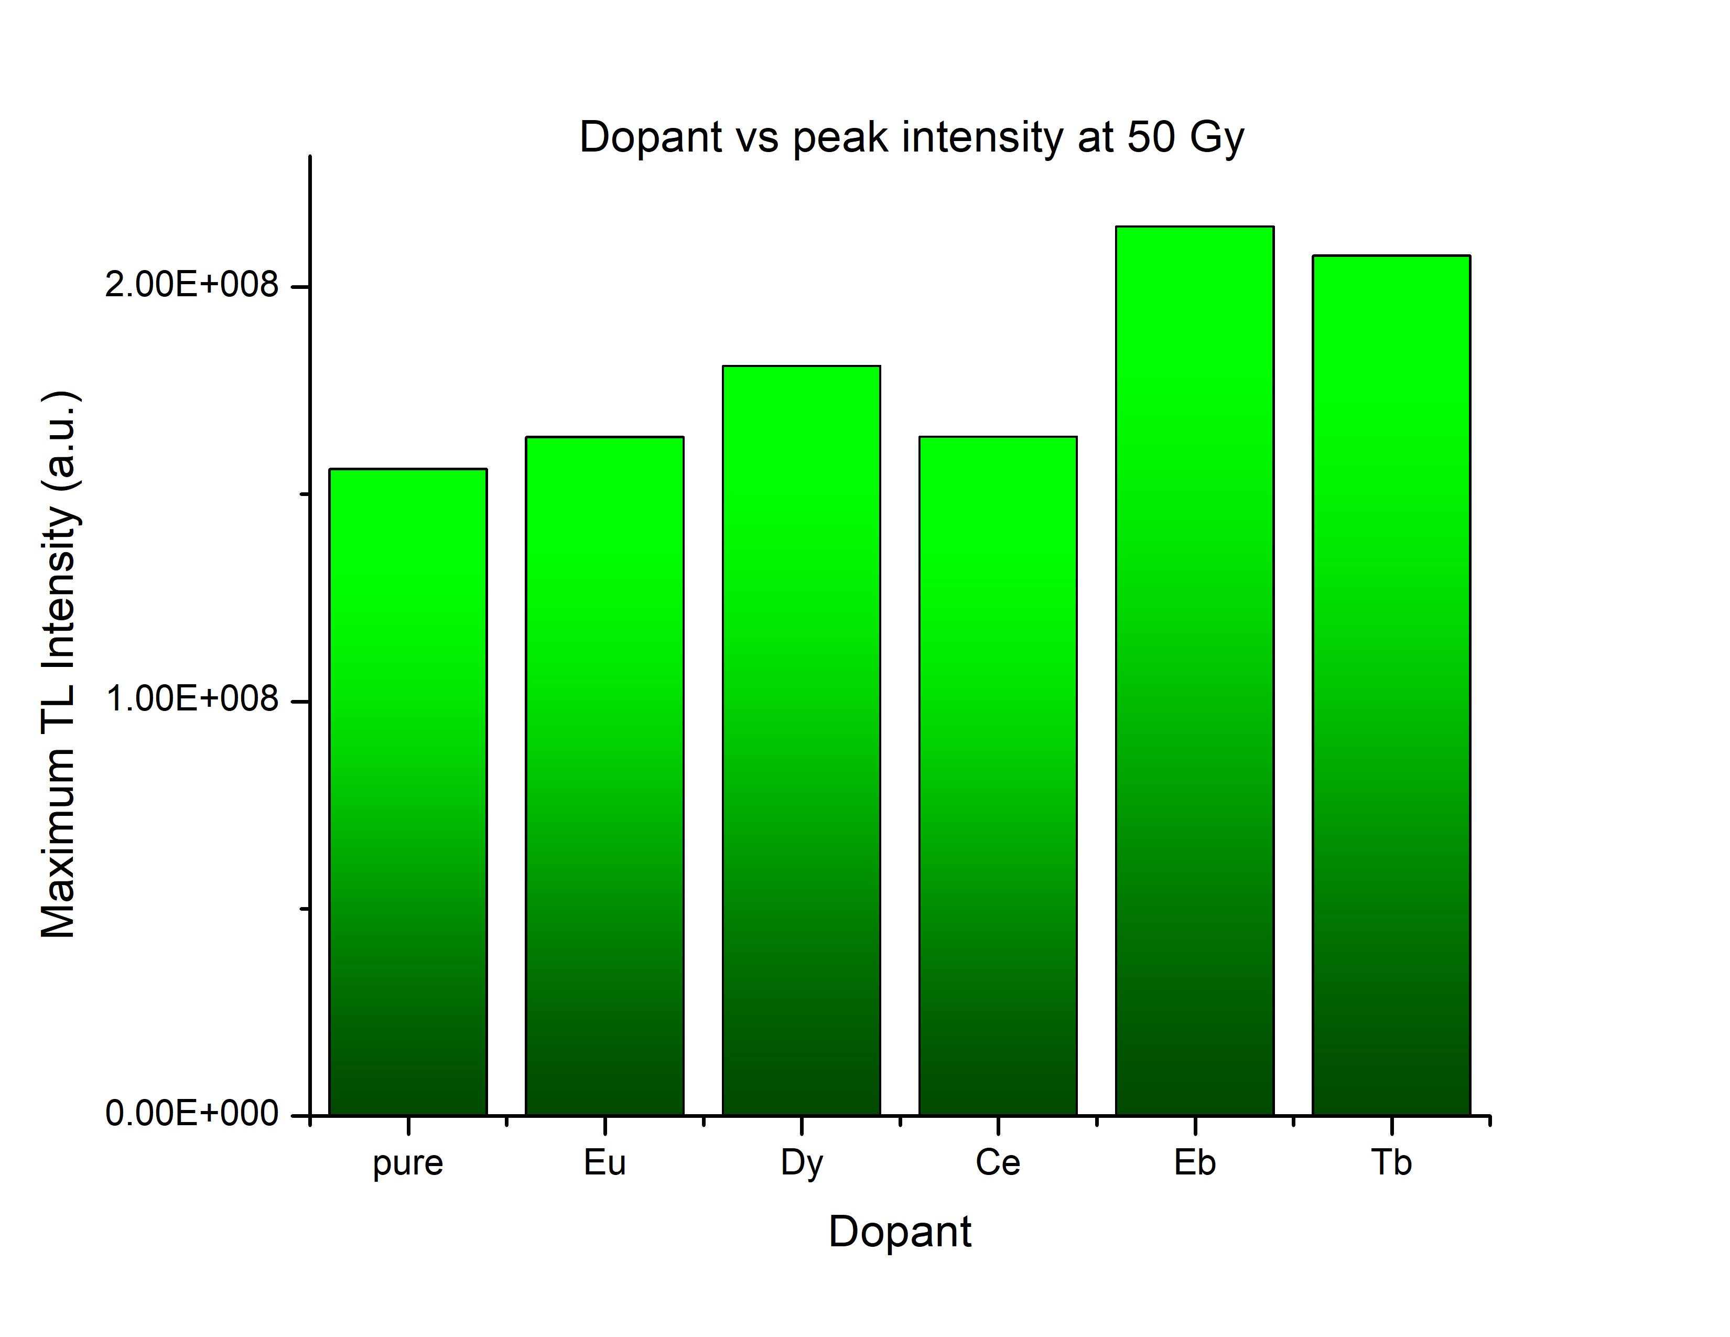
Peak intensity vs Dopant
•
•
•

Slide 21
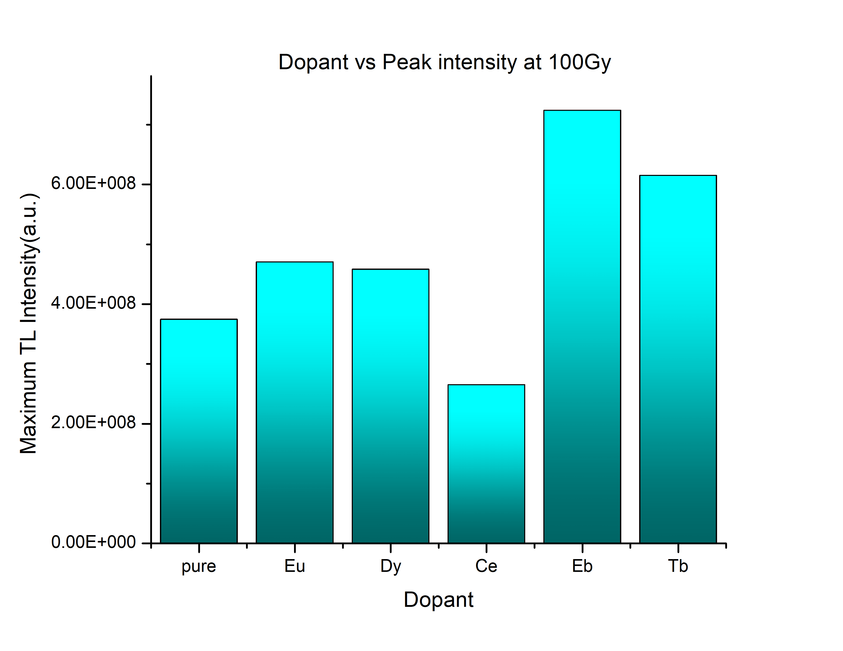
Peak intensity vs Dopant
•
•
•

Slide 22

CONCLUSION

Slide 23
CaNa₂(SO₄)₂
The TL glow curve of CaN a2 (SO4 )2 shows 2 peaks at around 113◦ C and 167◦ C for 50 Gy dose and at around 109◦ C and 166◦ C for 100Gy dose.
The sample of CaNa2 (SO4 )2 : Eu(0.1mol%) shows a very high intensity single TL glow peak at around 164 ◦ C.
This shows that the addition of dopant enhances the thermoluminescent properties of CaN a2 (SO4 )2 .

Slide 24
Li₂SiO₃
The main feature of lithium metasilicate is its high sensitivity to ionizing radiation for a wide energy range.
Also, Li2 SiO3 (Zef f = 10.5) being low Z materials, are near tissue equivalent and may find application in the field of radiation dosimetry.
Lithium metasilicate yields glow curves with two to three major peaks.
On addition of dopants, the thermoluminescence intensities in much higher than that of undoped sample.
Doping with Terbium and Erbium results in maximum intensities for 50 Gy and 100 Gy gammma irradiation.

Slide 25


